Slide 1

Pizza Sales Analysis With SQL | MR. Mehar
Basic | Intermediate | Advanced

Slide 2
Objective
The objective of this pizza sales data analysis project is to utilize Structured Query Language (SQL) to gain insights into various aspects of the pizza sales business, such as popular toppings, busiest days of the week, and highest-selling pizza sizes and crust types. The results can be used to inform marketing and inventory decisions, as well as improve overall business operations.

Slide 3
Tables To Be Served
Pizzas
Pizza_types
Orders
Order_details

Slide 4
Basic

Slide 5
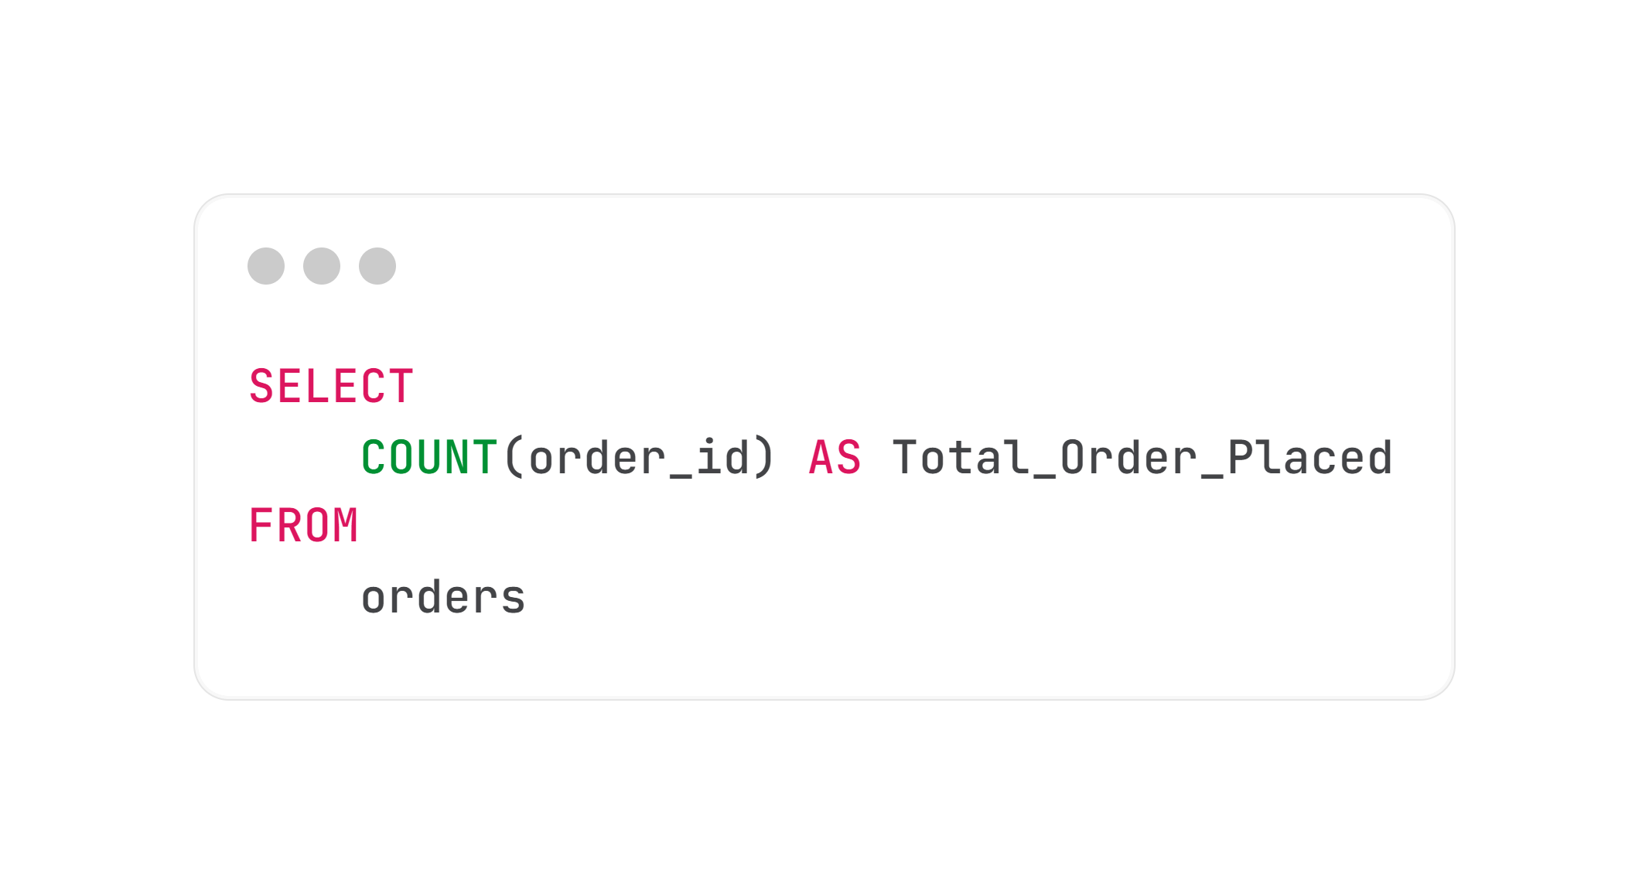
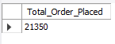
1. Retrieve The Total Number Of Orders Placed:
SQL Query : ---------------------------------------------------------------------------------------------------------------
Result : -------------------------------------------------------------------------------------------------------------------------

Slide 6
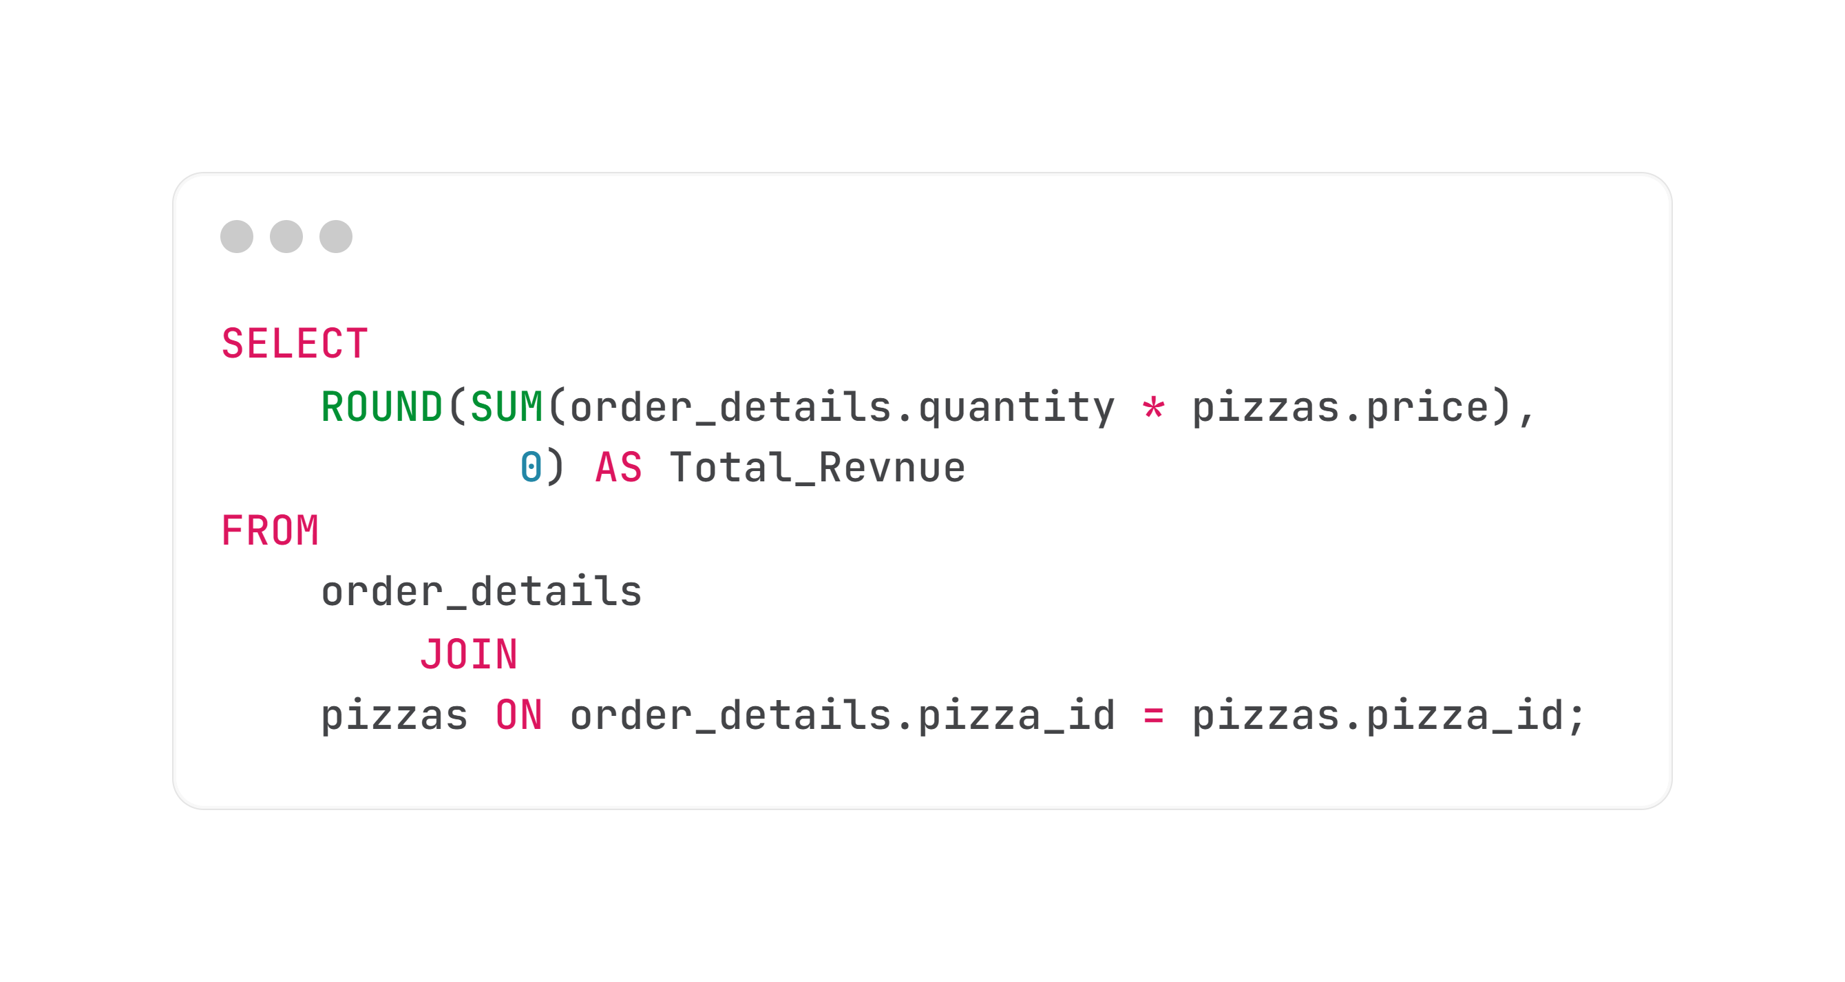
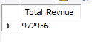
2. Calculate The Total Revenue Generated From Pizza Sales:
SQL Query : ---------------------------------------------------------------------------------------------------------------
Result : -------------------------------------------------------------------------------------------------------------------------

Slide 7
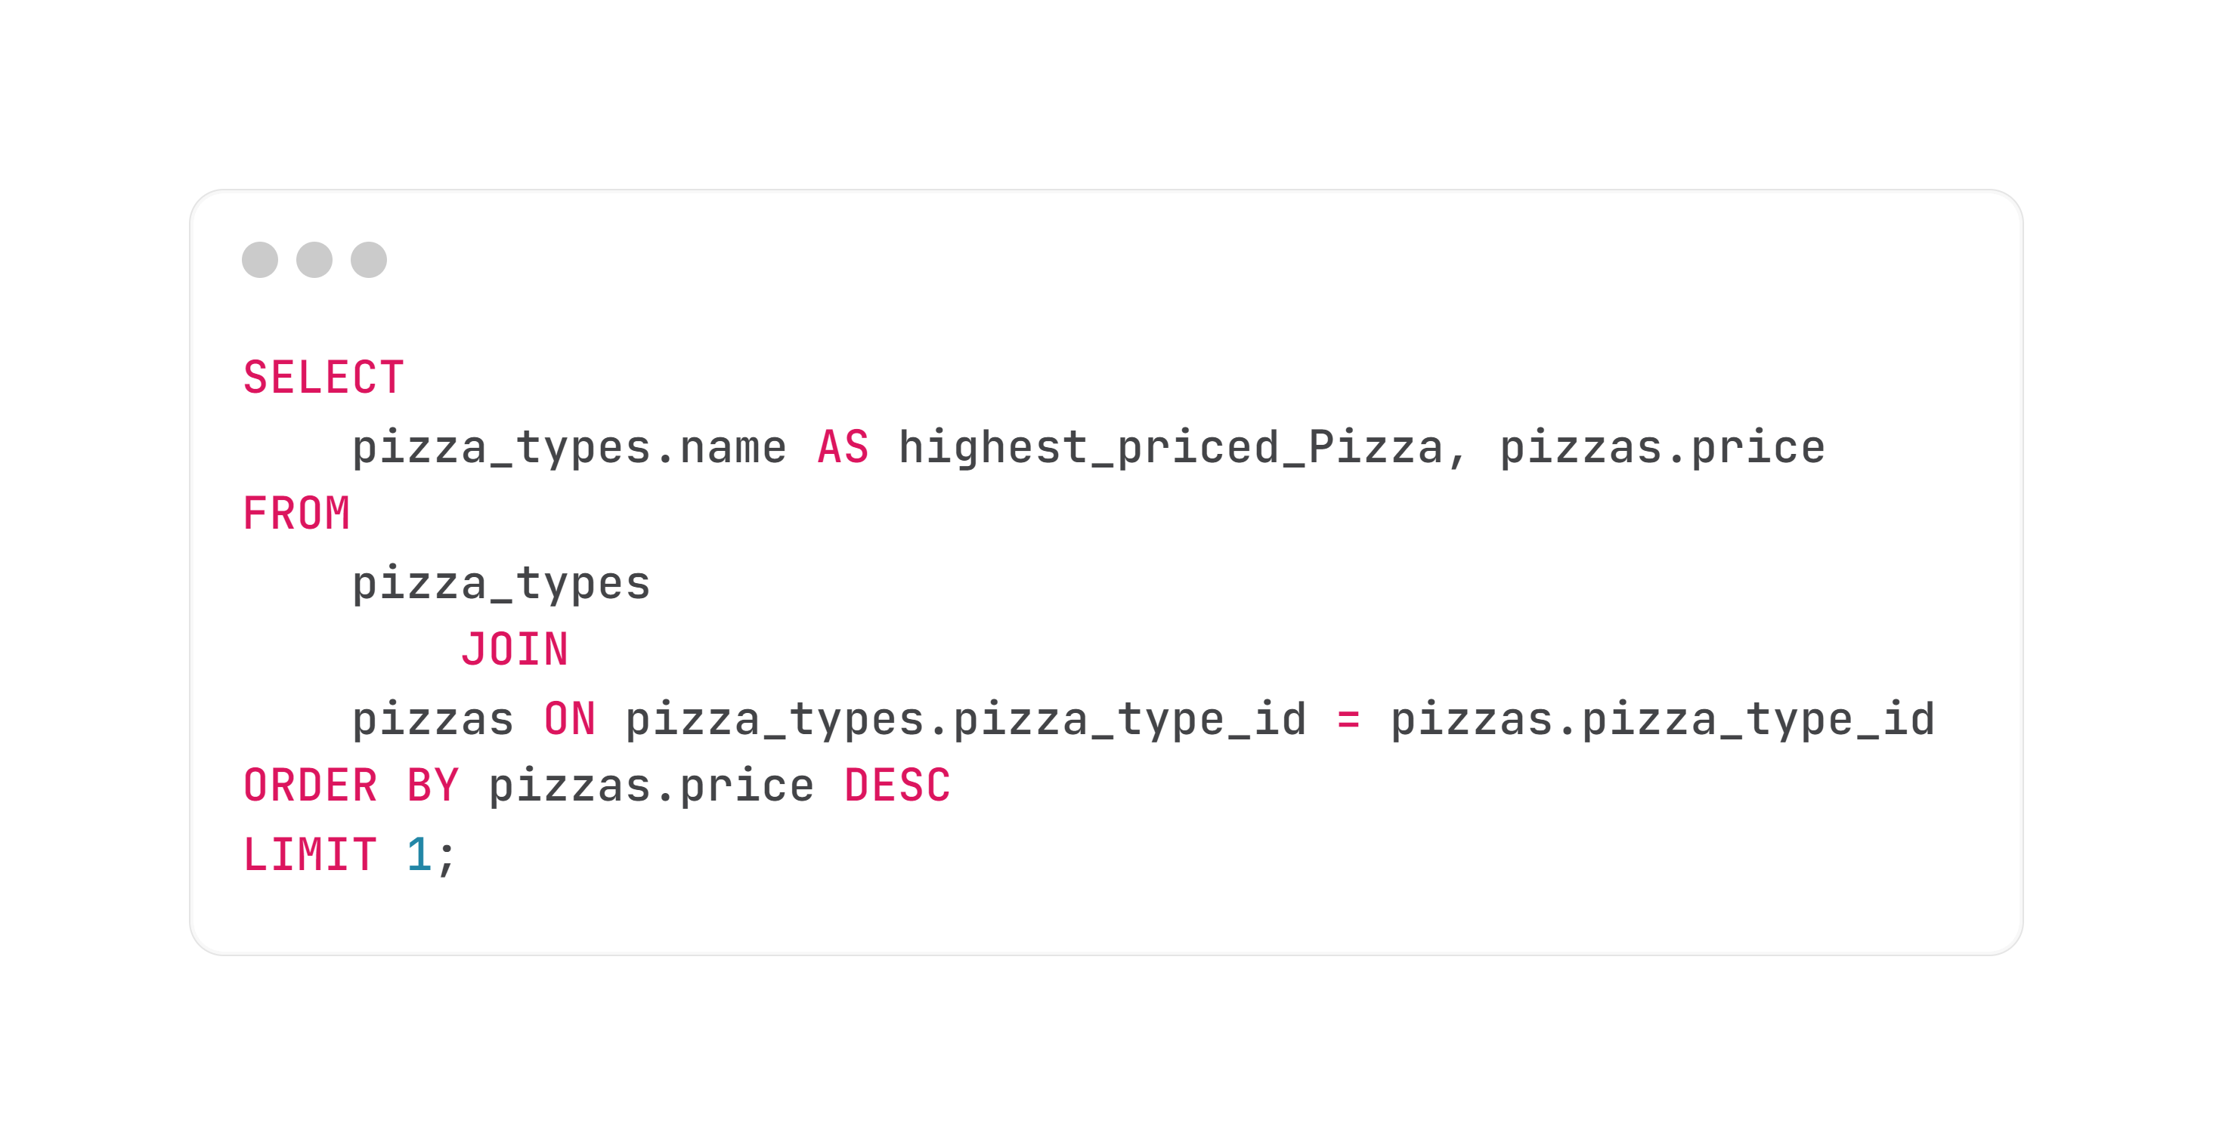
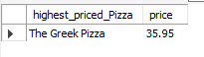
3. Identify The Highest Priced Pizza:
SQL Query : ---------------------------------------------------------------------------------------------------------------
Result : -------------------------------------------------------------------------------------------------------------------------

Slide 8
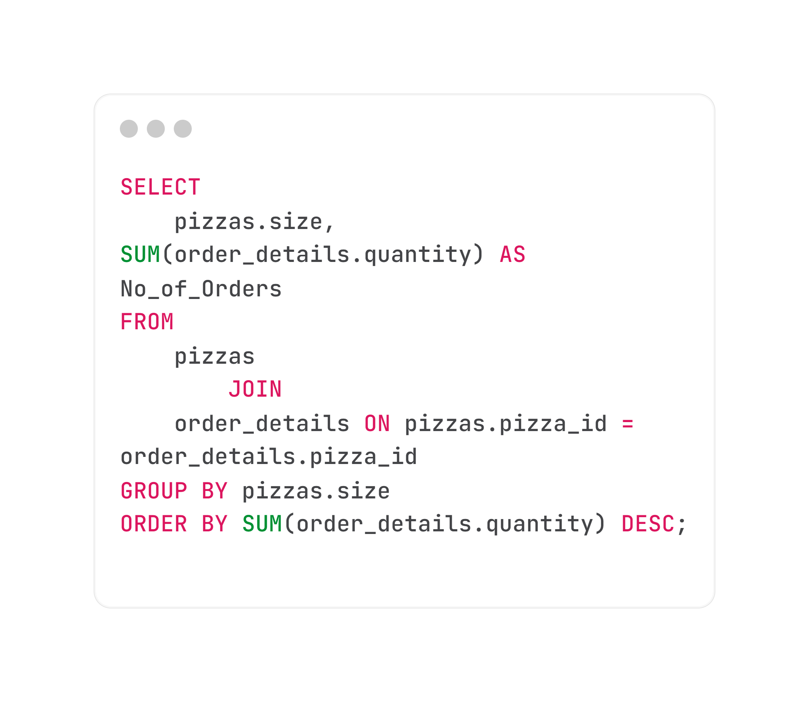
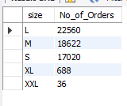
4. Identify The Most Common Pizza Size Ordered:
SQL Query :
Result :

Slide 9
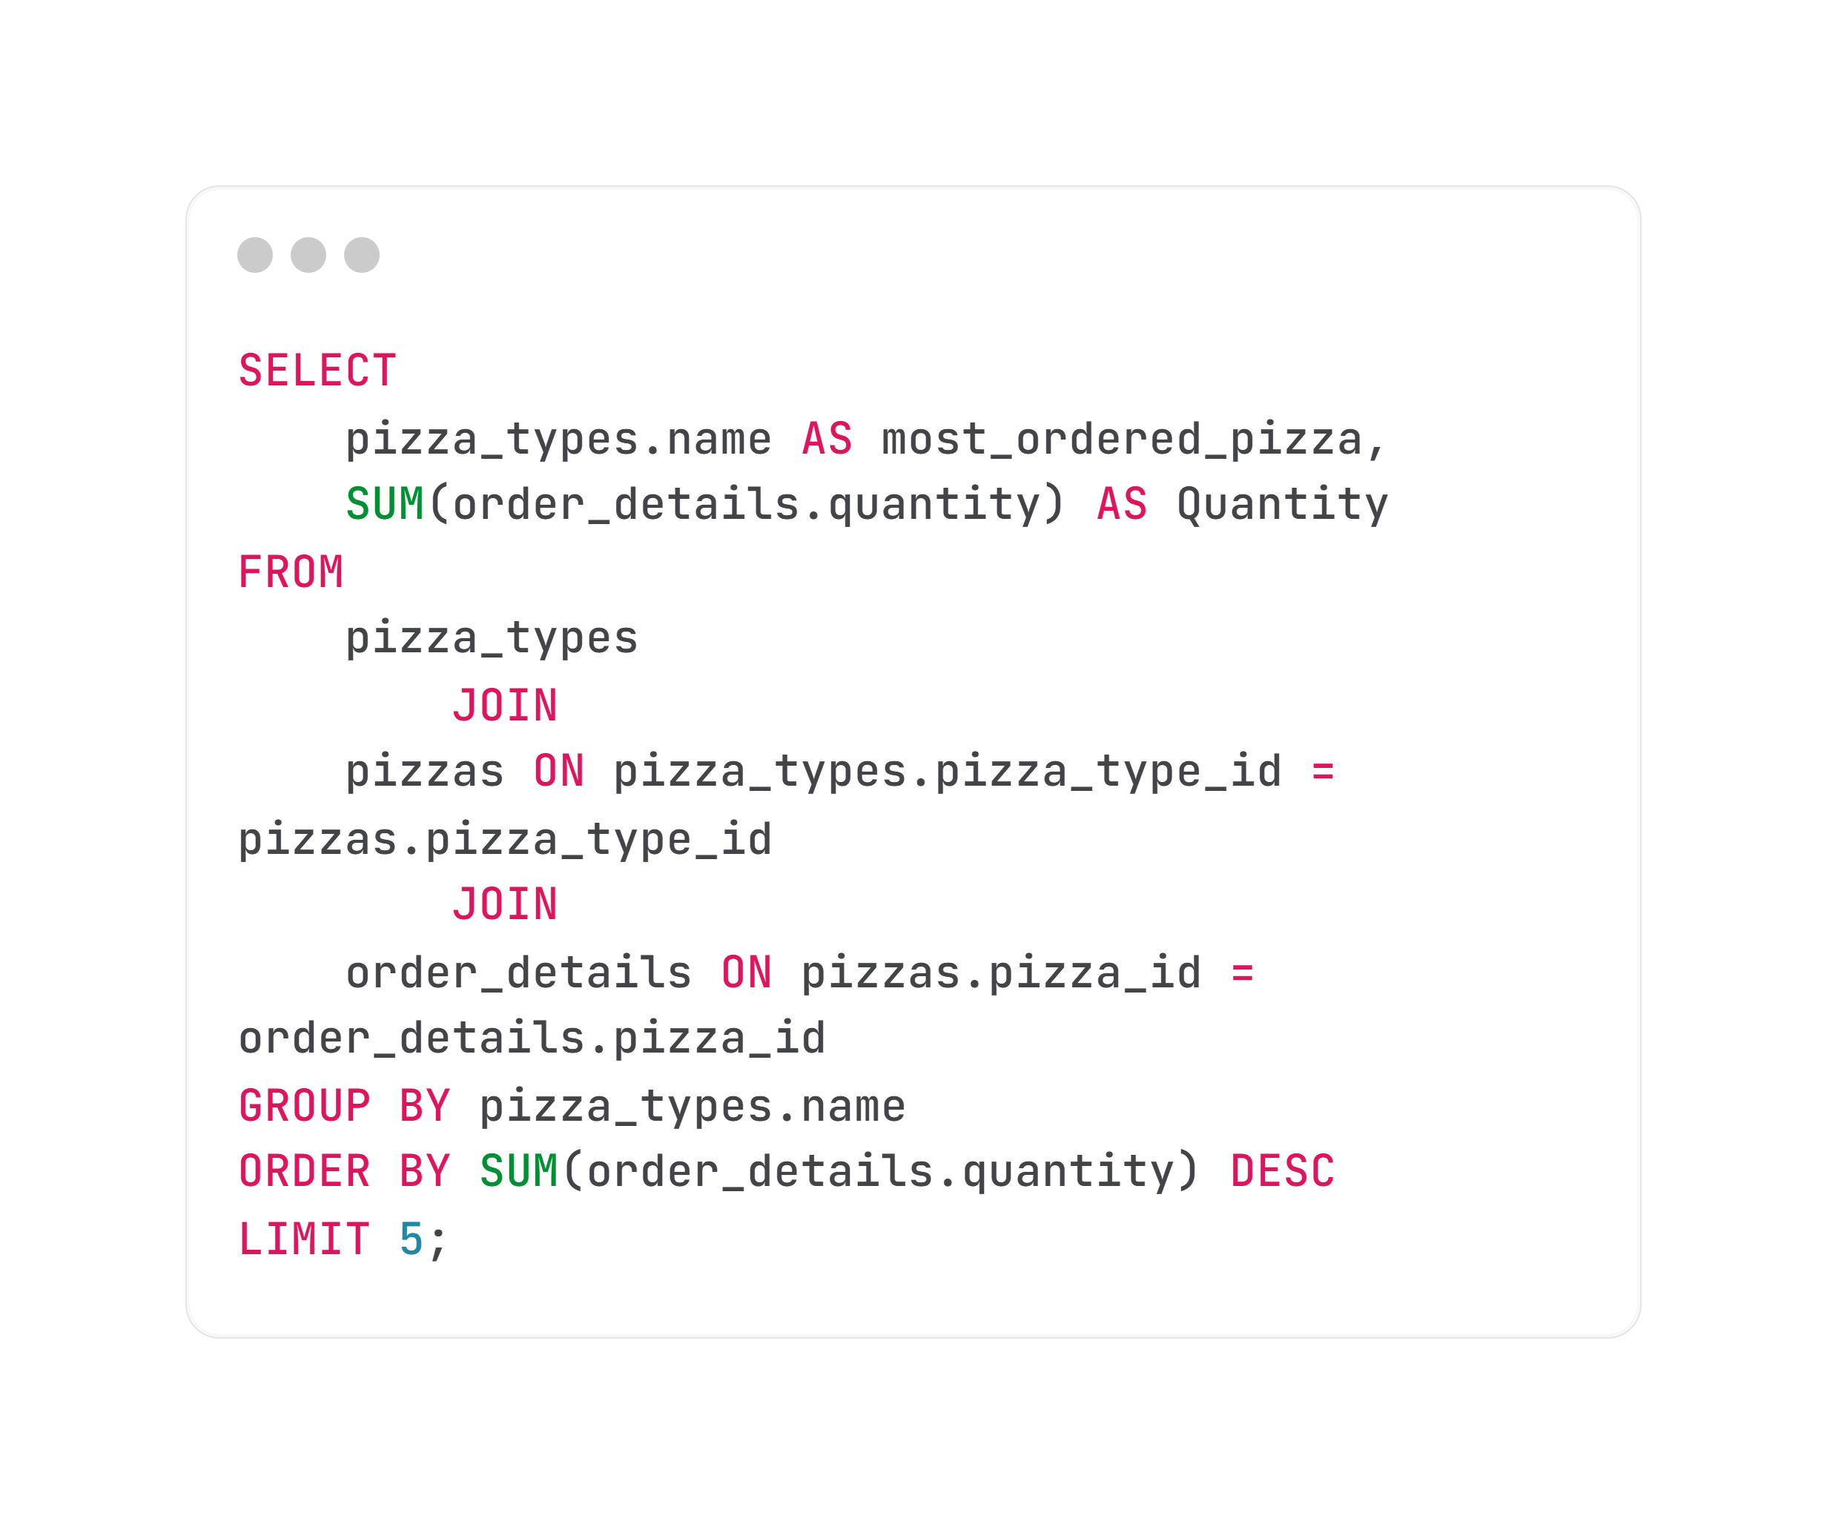
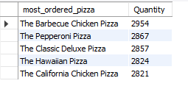
5. List The Top 5 Most Ordered Pizza Types Along With Their Quantities:
SQL Query :
Result :

Slide 10
Intermediate

Slide 11
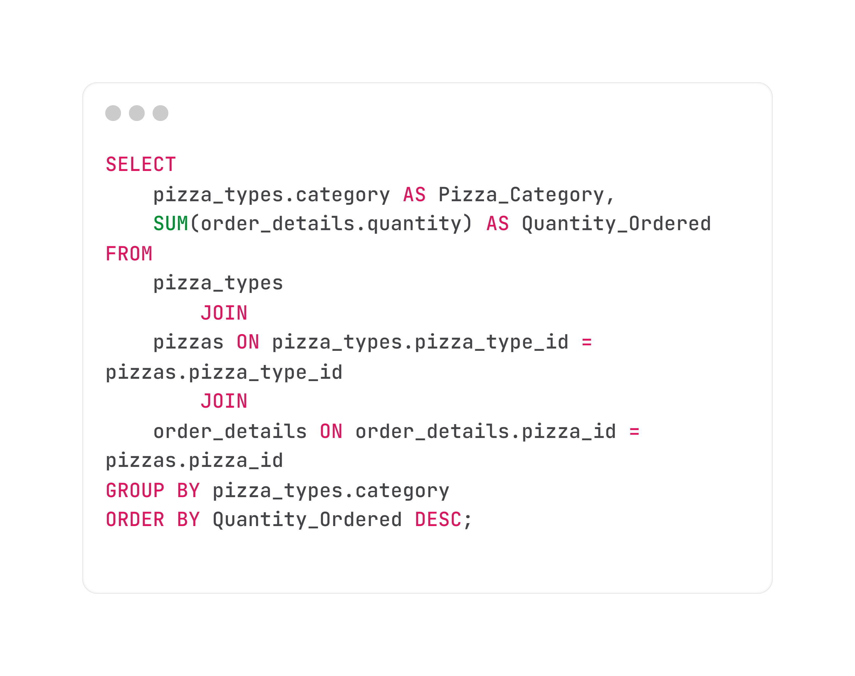
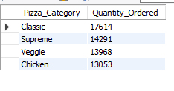
6. Join The Necessary Tables To Find The Total Quantity Of Each Pizza Category Ordered:
SQL Query :
Result :

Slide 12
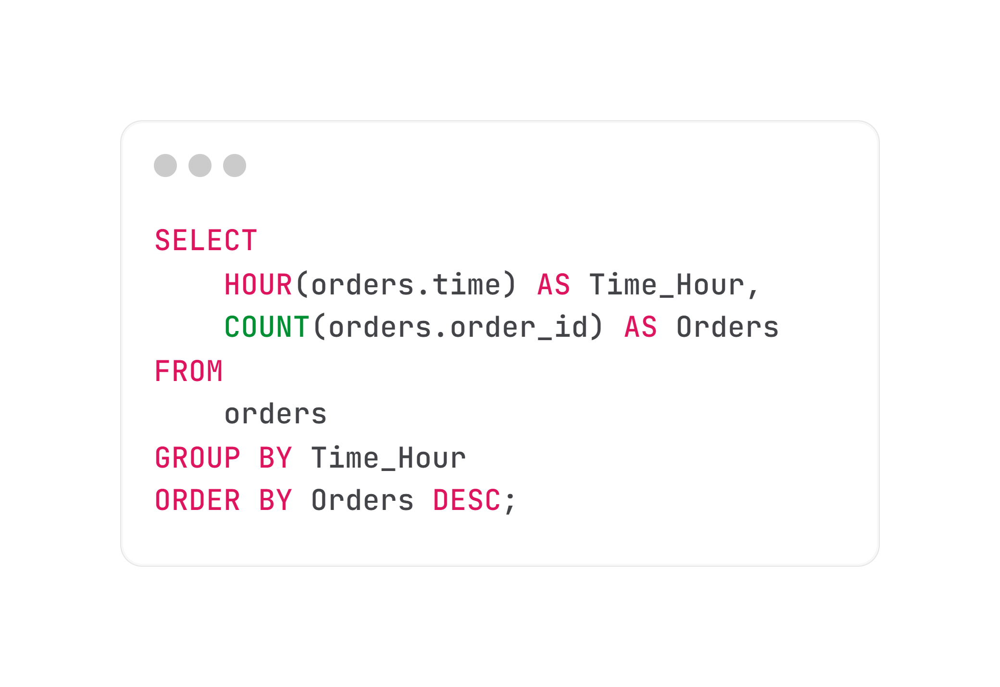
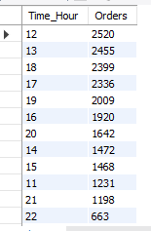
7. Determine The Distribution Of Orders By Hour Of The Day:
SQL Query :
Result :

Slide 13
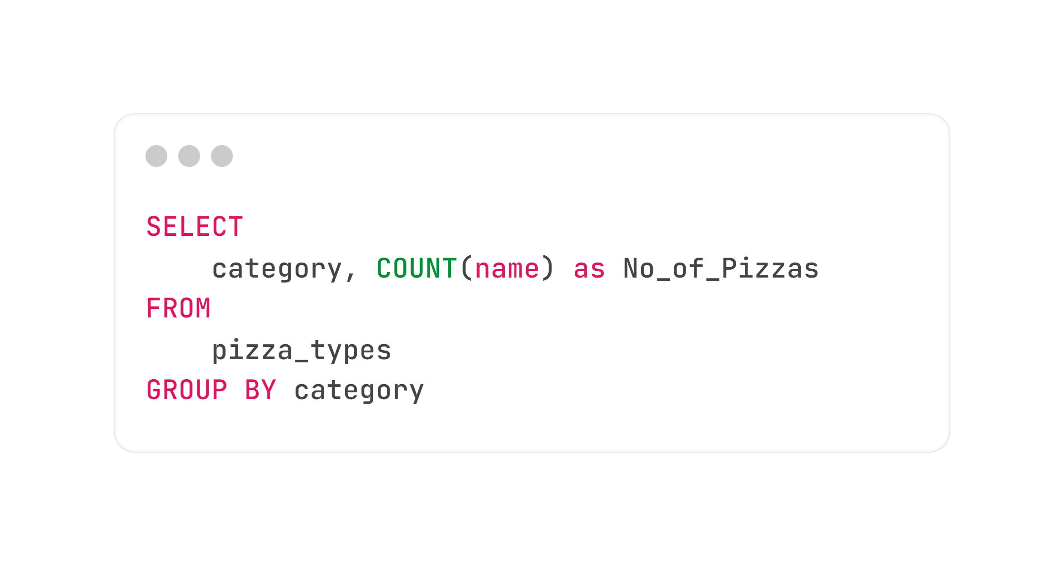
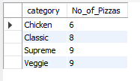
8. Find The Category-wise Distribution Of Pizzas:
SQL Query :
Result :

Slide 14
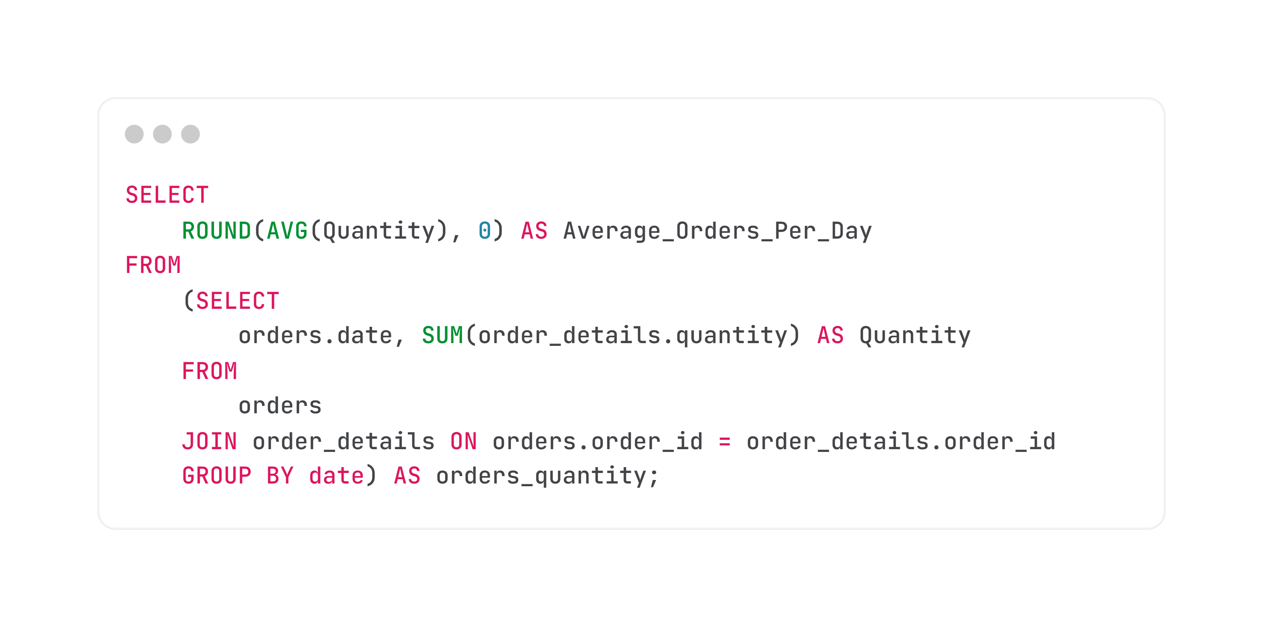
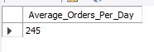
9. Group The Orders By Date And Calculate The Average Number Of Pizzas Ordered Per Day:
SQL Query : ---------------------------------------------------------------------------------------------------------------
Result : -------------------------------------------------------------------------------------------------------------------------

Slide 15
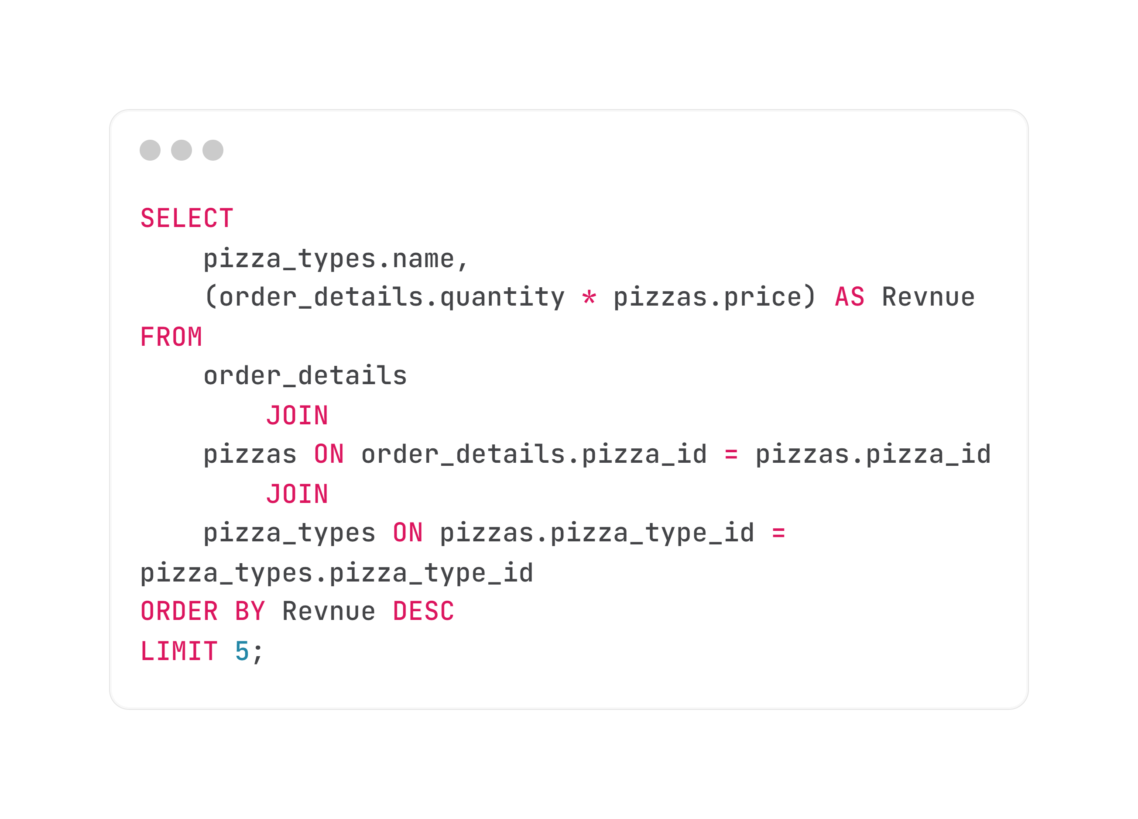
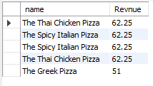
10. Determine The Top 5 Most Ordered Pizza Types Based On Revenue:
SQL Query :
Result :

Slide 16
Advance

Slide 17
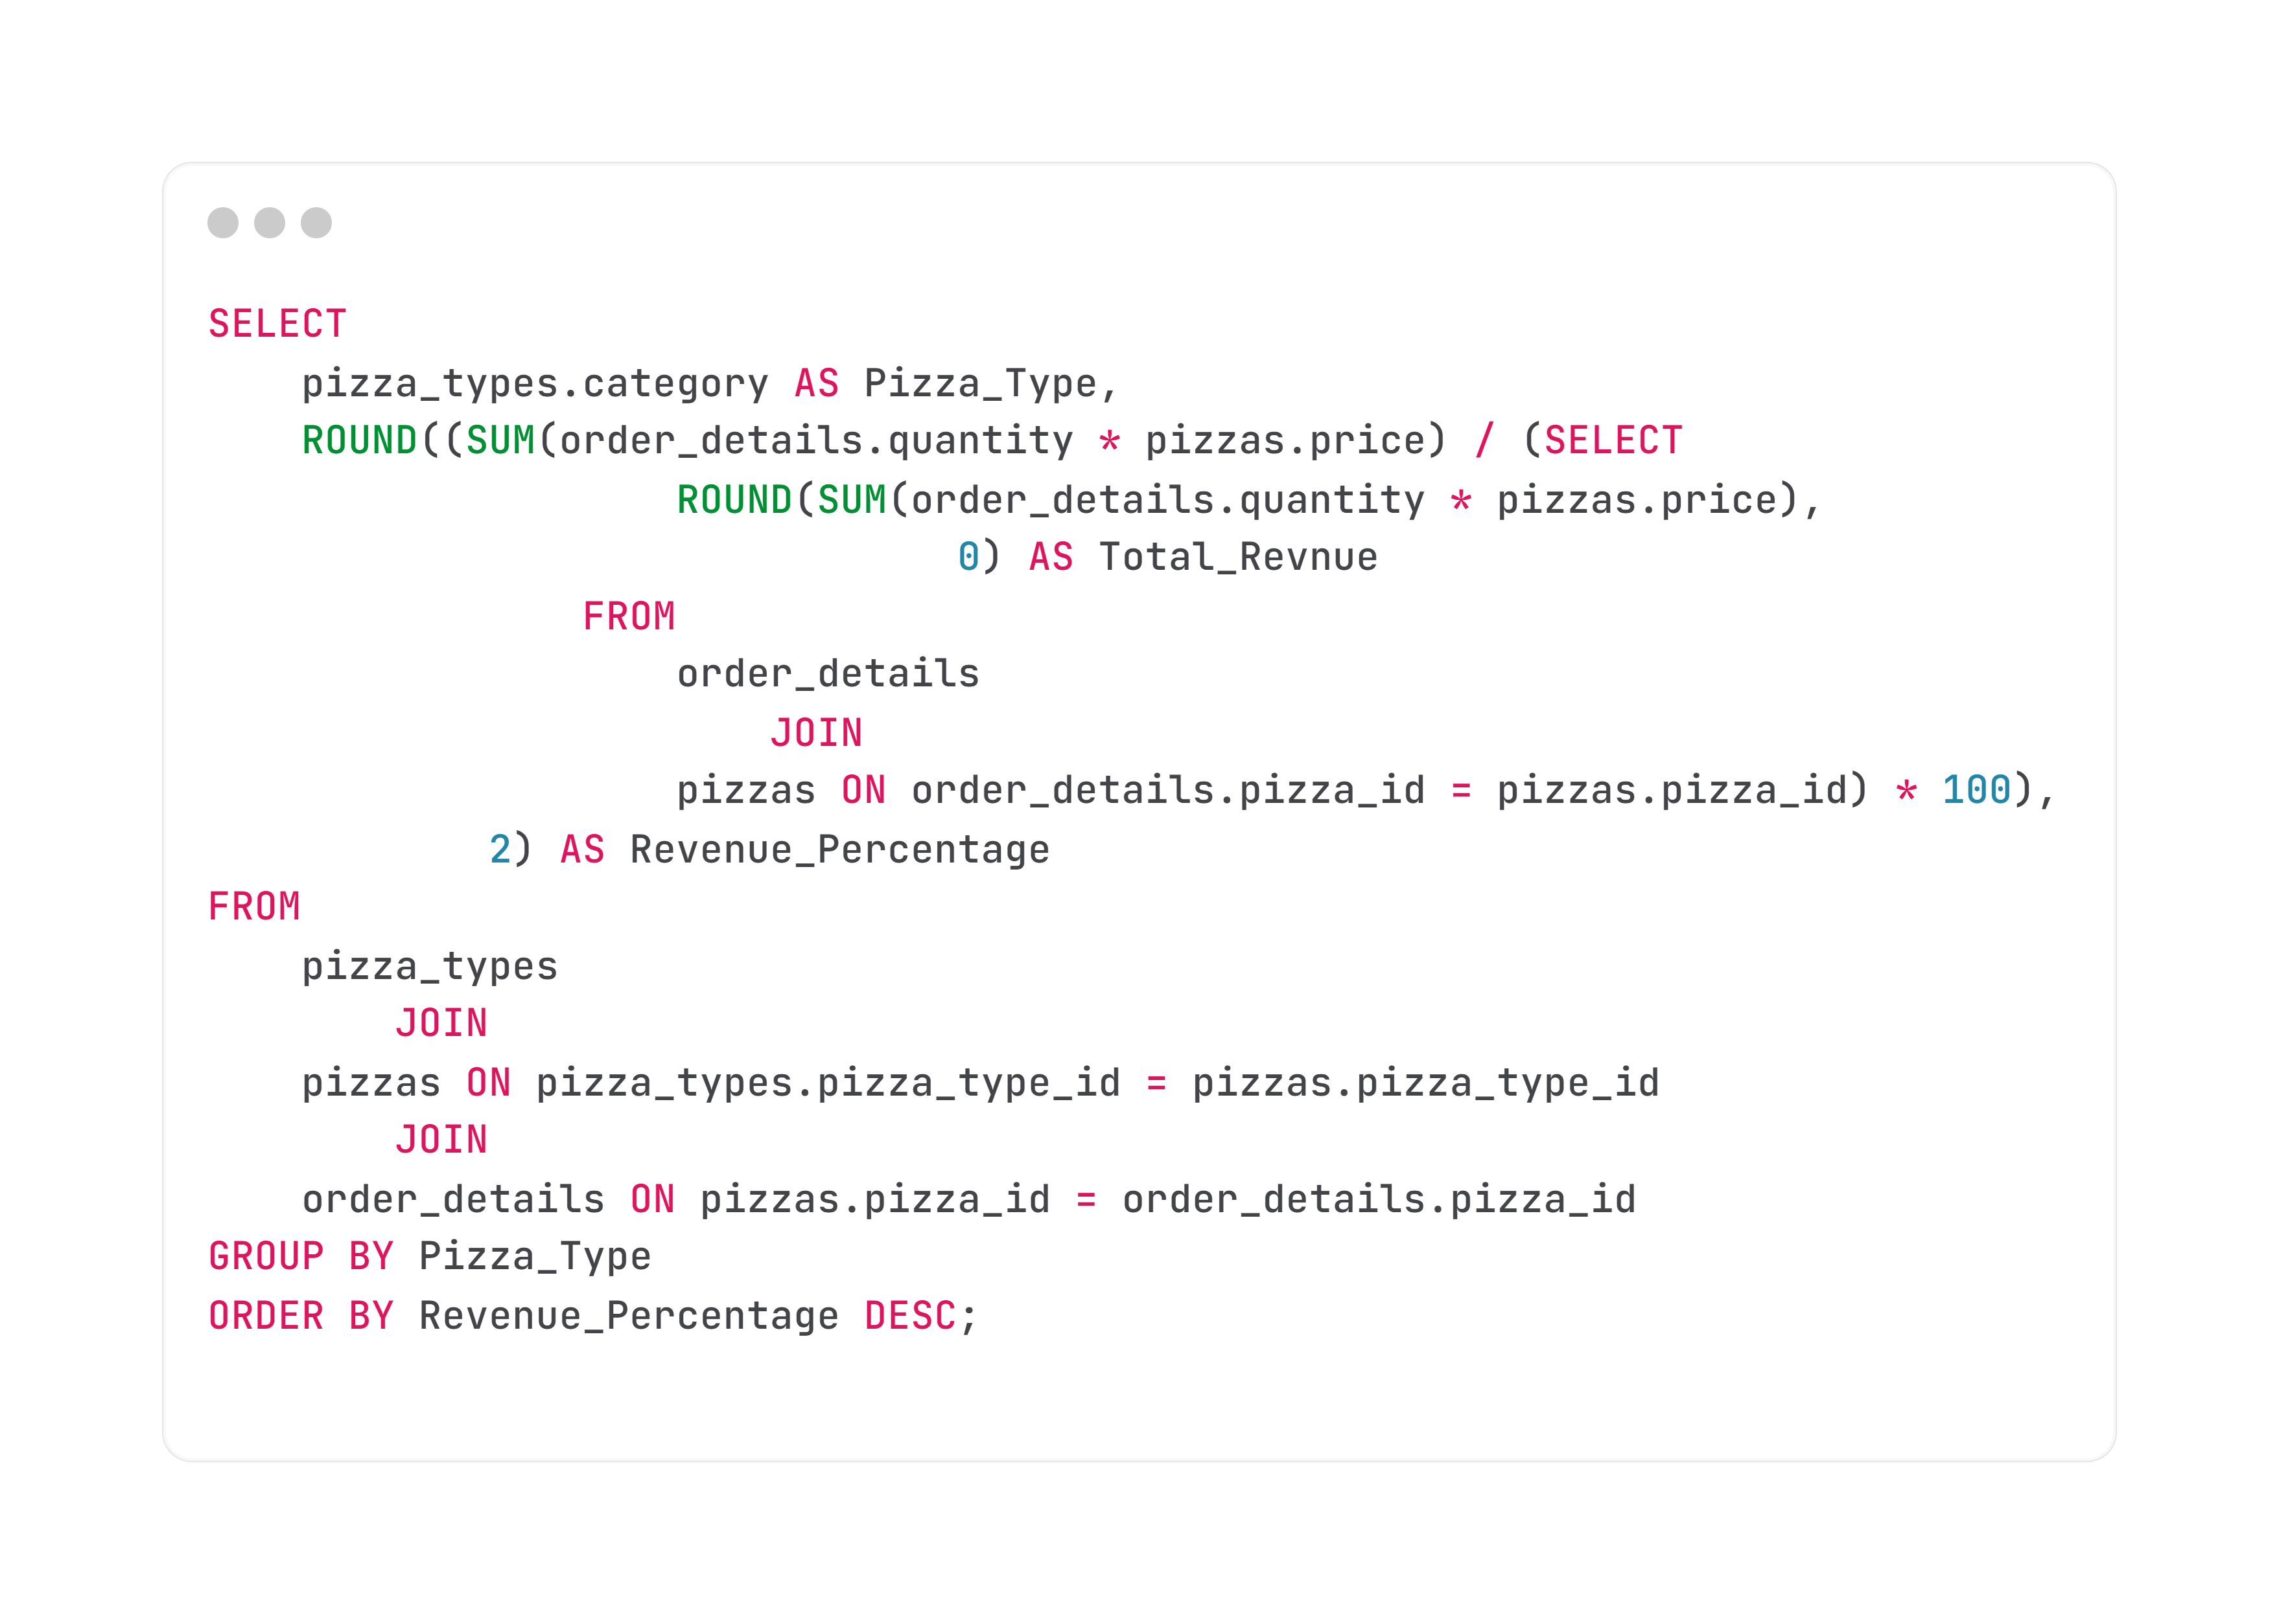
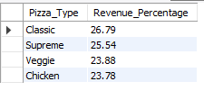
11. Calculate The Percentage Contribution Of Each Pizza Type To Total Revenue:
SQL Query :
Result :

Slide 18
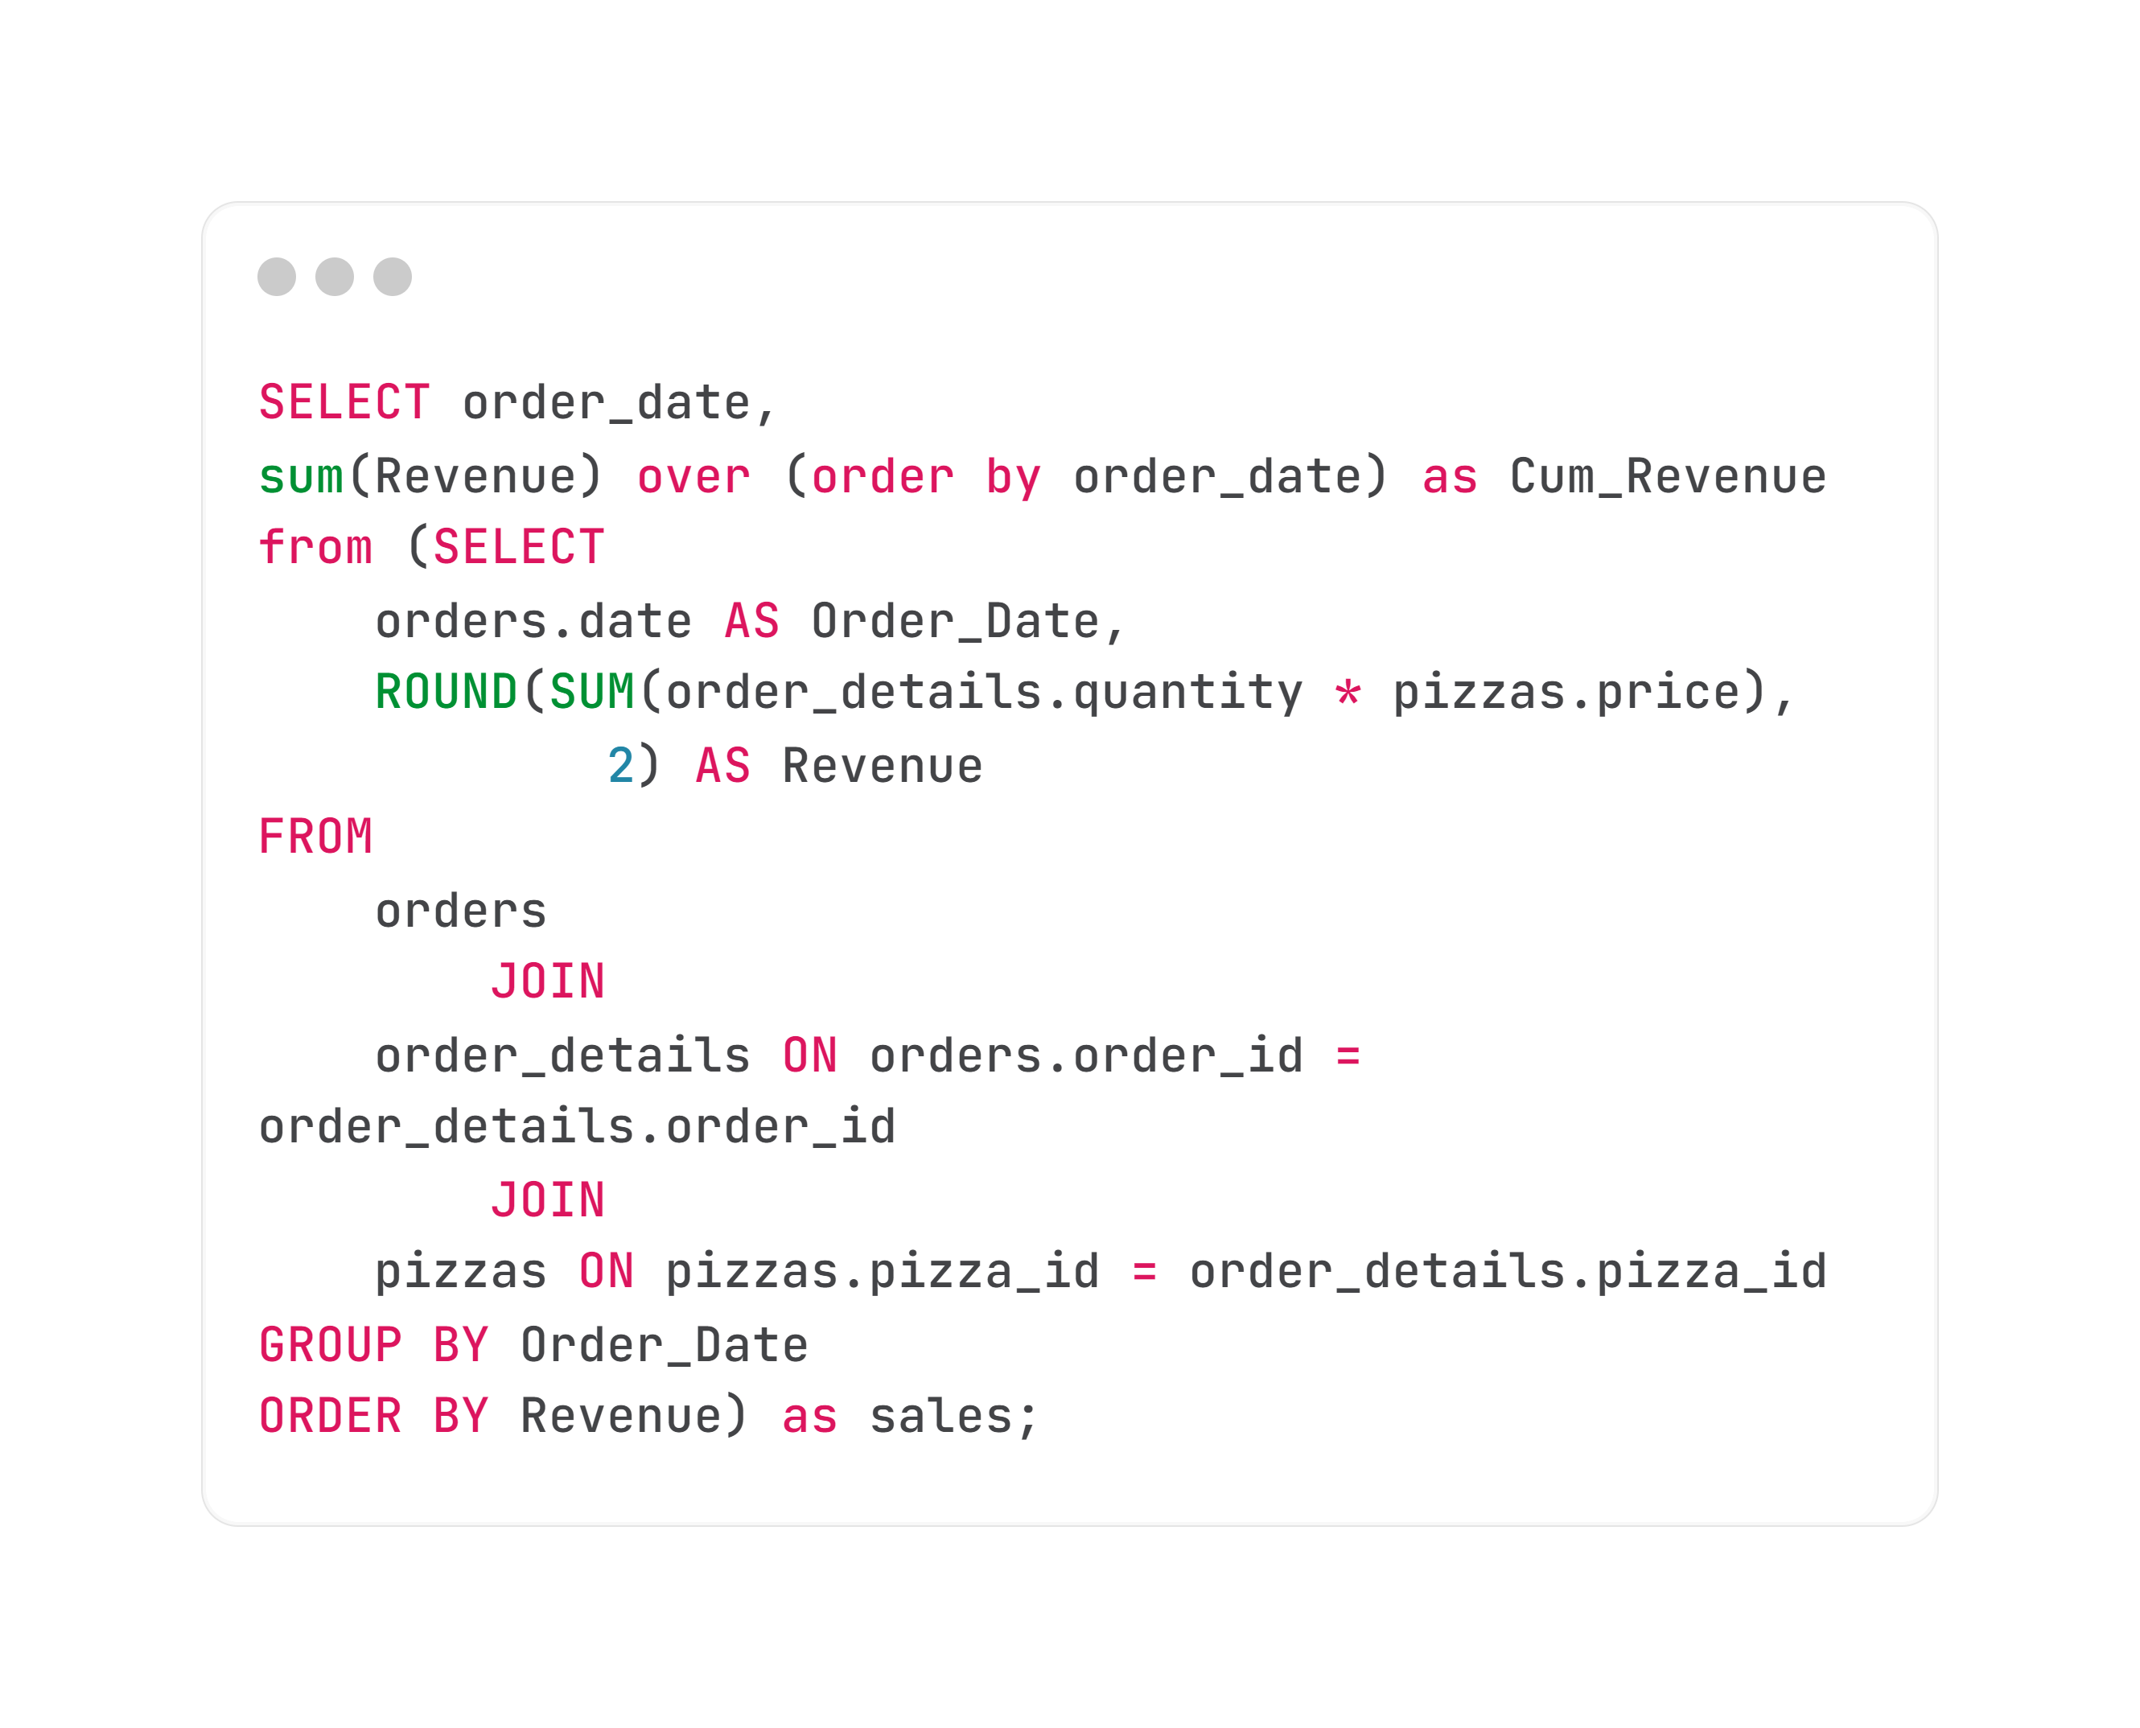
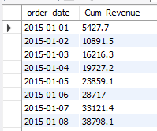
12. Analyze The Cumulative Revenue Generated Over Time:
SQL Query :
Result :

Slide 19
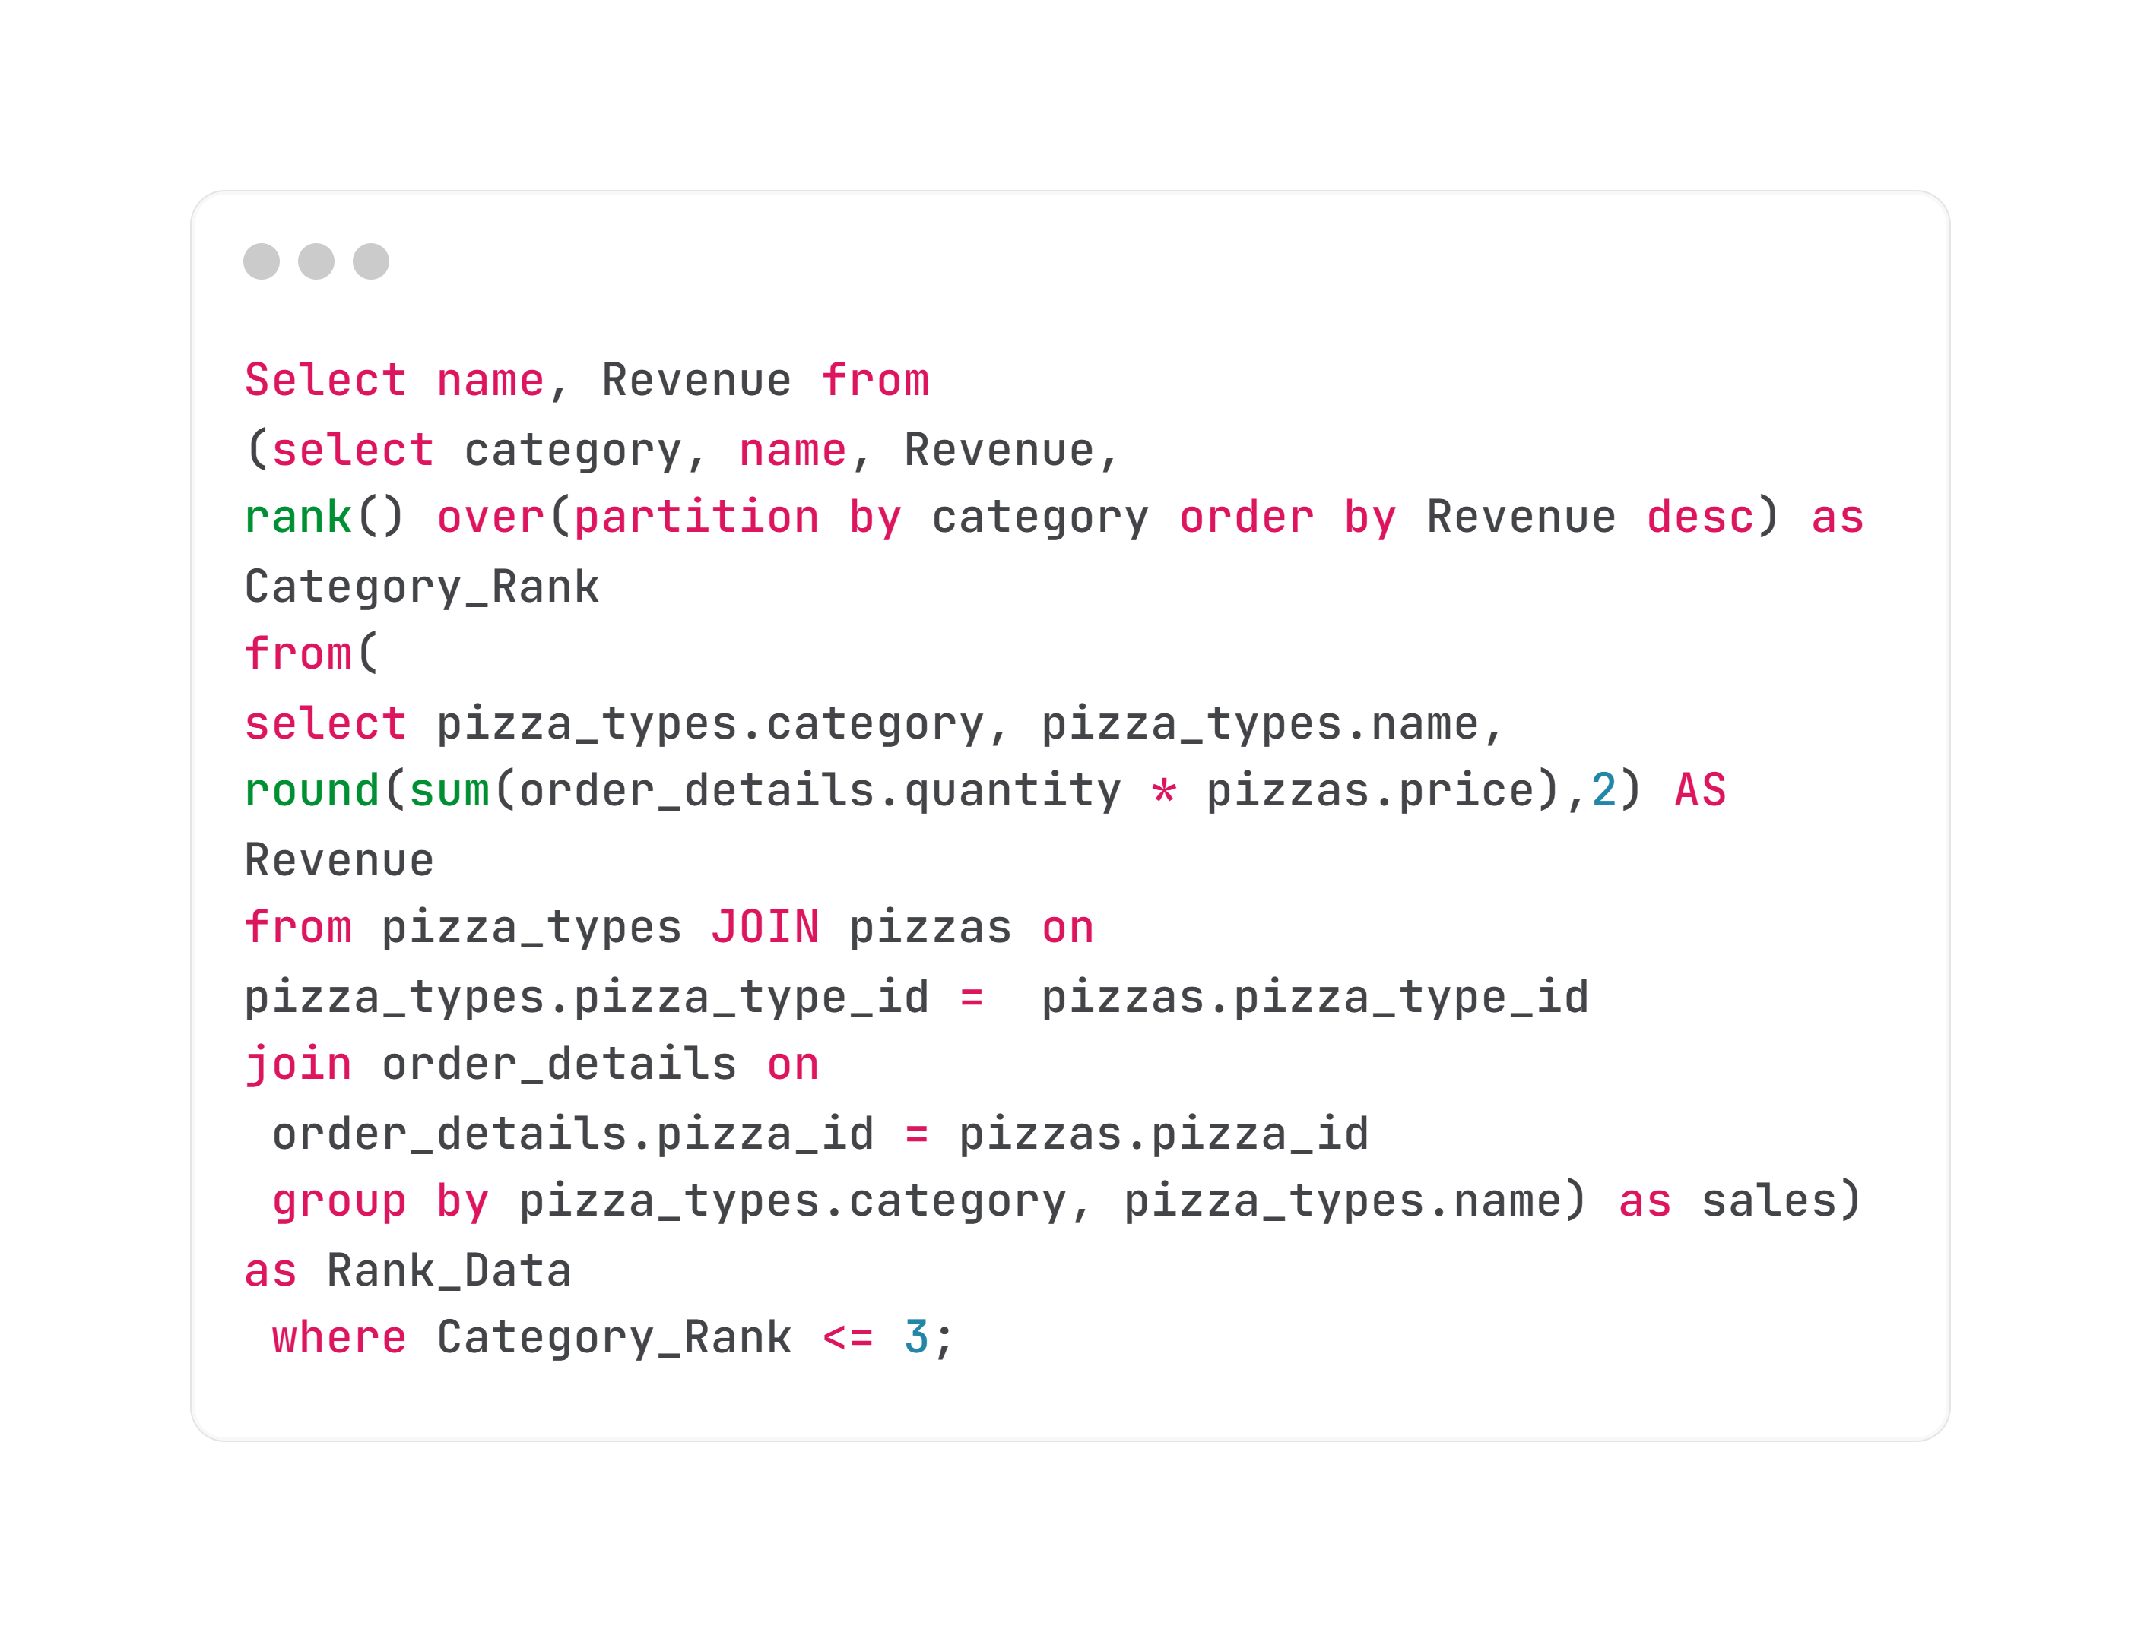
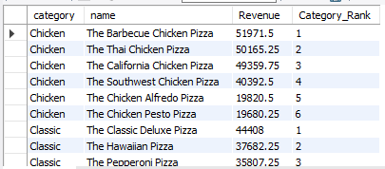
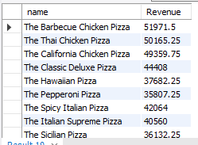
13. Determine The Top 3 Most Ordered Pizza Types Based On Revenue For Each Pizza Category:
SQL Query :
Result :
-----------------------------------------------------------------------

Slide 20


THANK YOU!
Mr. Mehar |

